Slide 1

Automated Hyperspectral Pyrometry of Bulk Crystal Growths
Naman Parikh¹, Tyrel McQueen^{3,4,5,6}, David Elbert^{2,3}
¹Carnegie Mellon University, ²Institute for Data Intensive Engineering and Sciences, ³Hopkins Extreme Materials Institute, ⁴JHU Department of Materials Science and Engineering, ⁵JHU Department of Chemistry, ⁶Institute for Quantum Matter

Slide 2
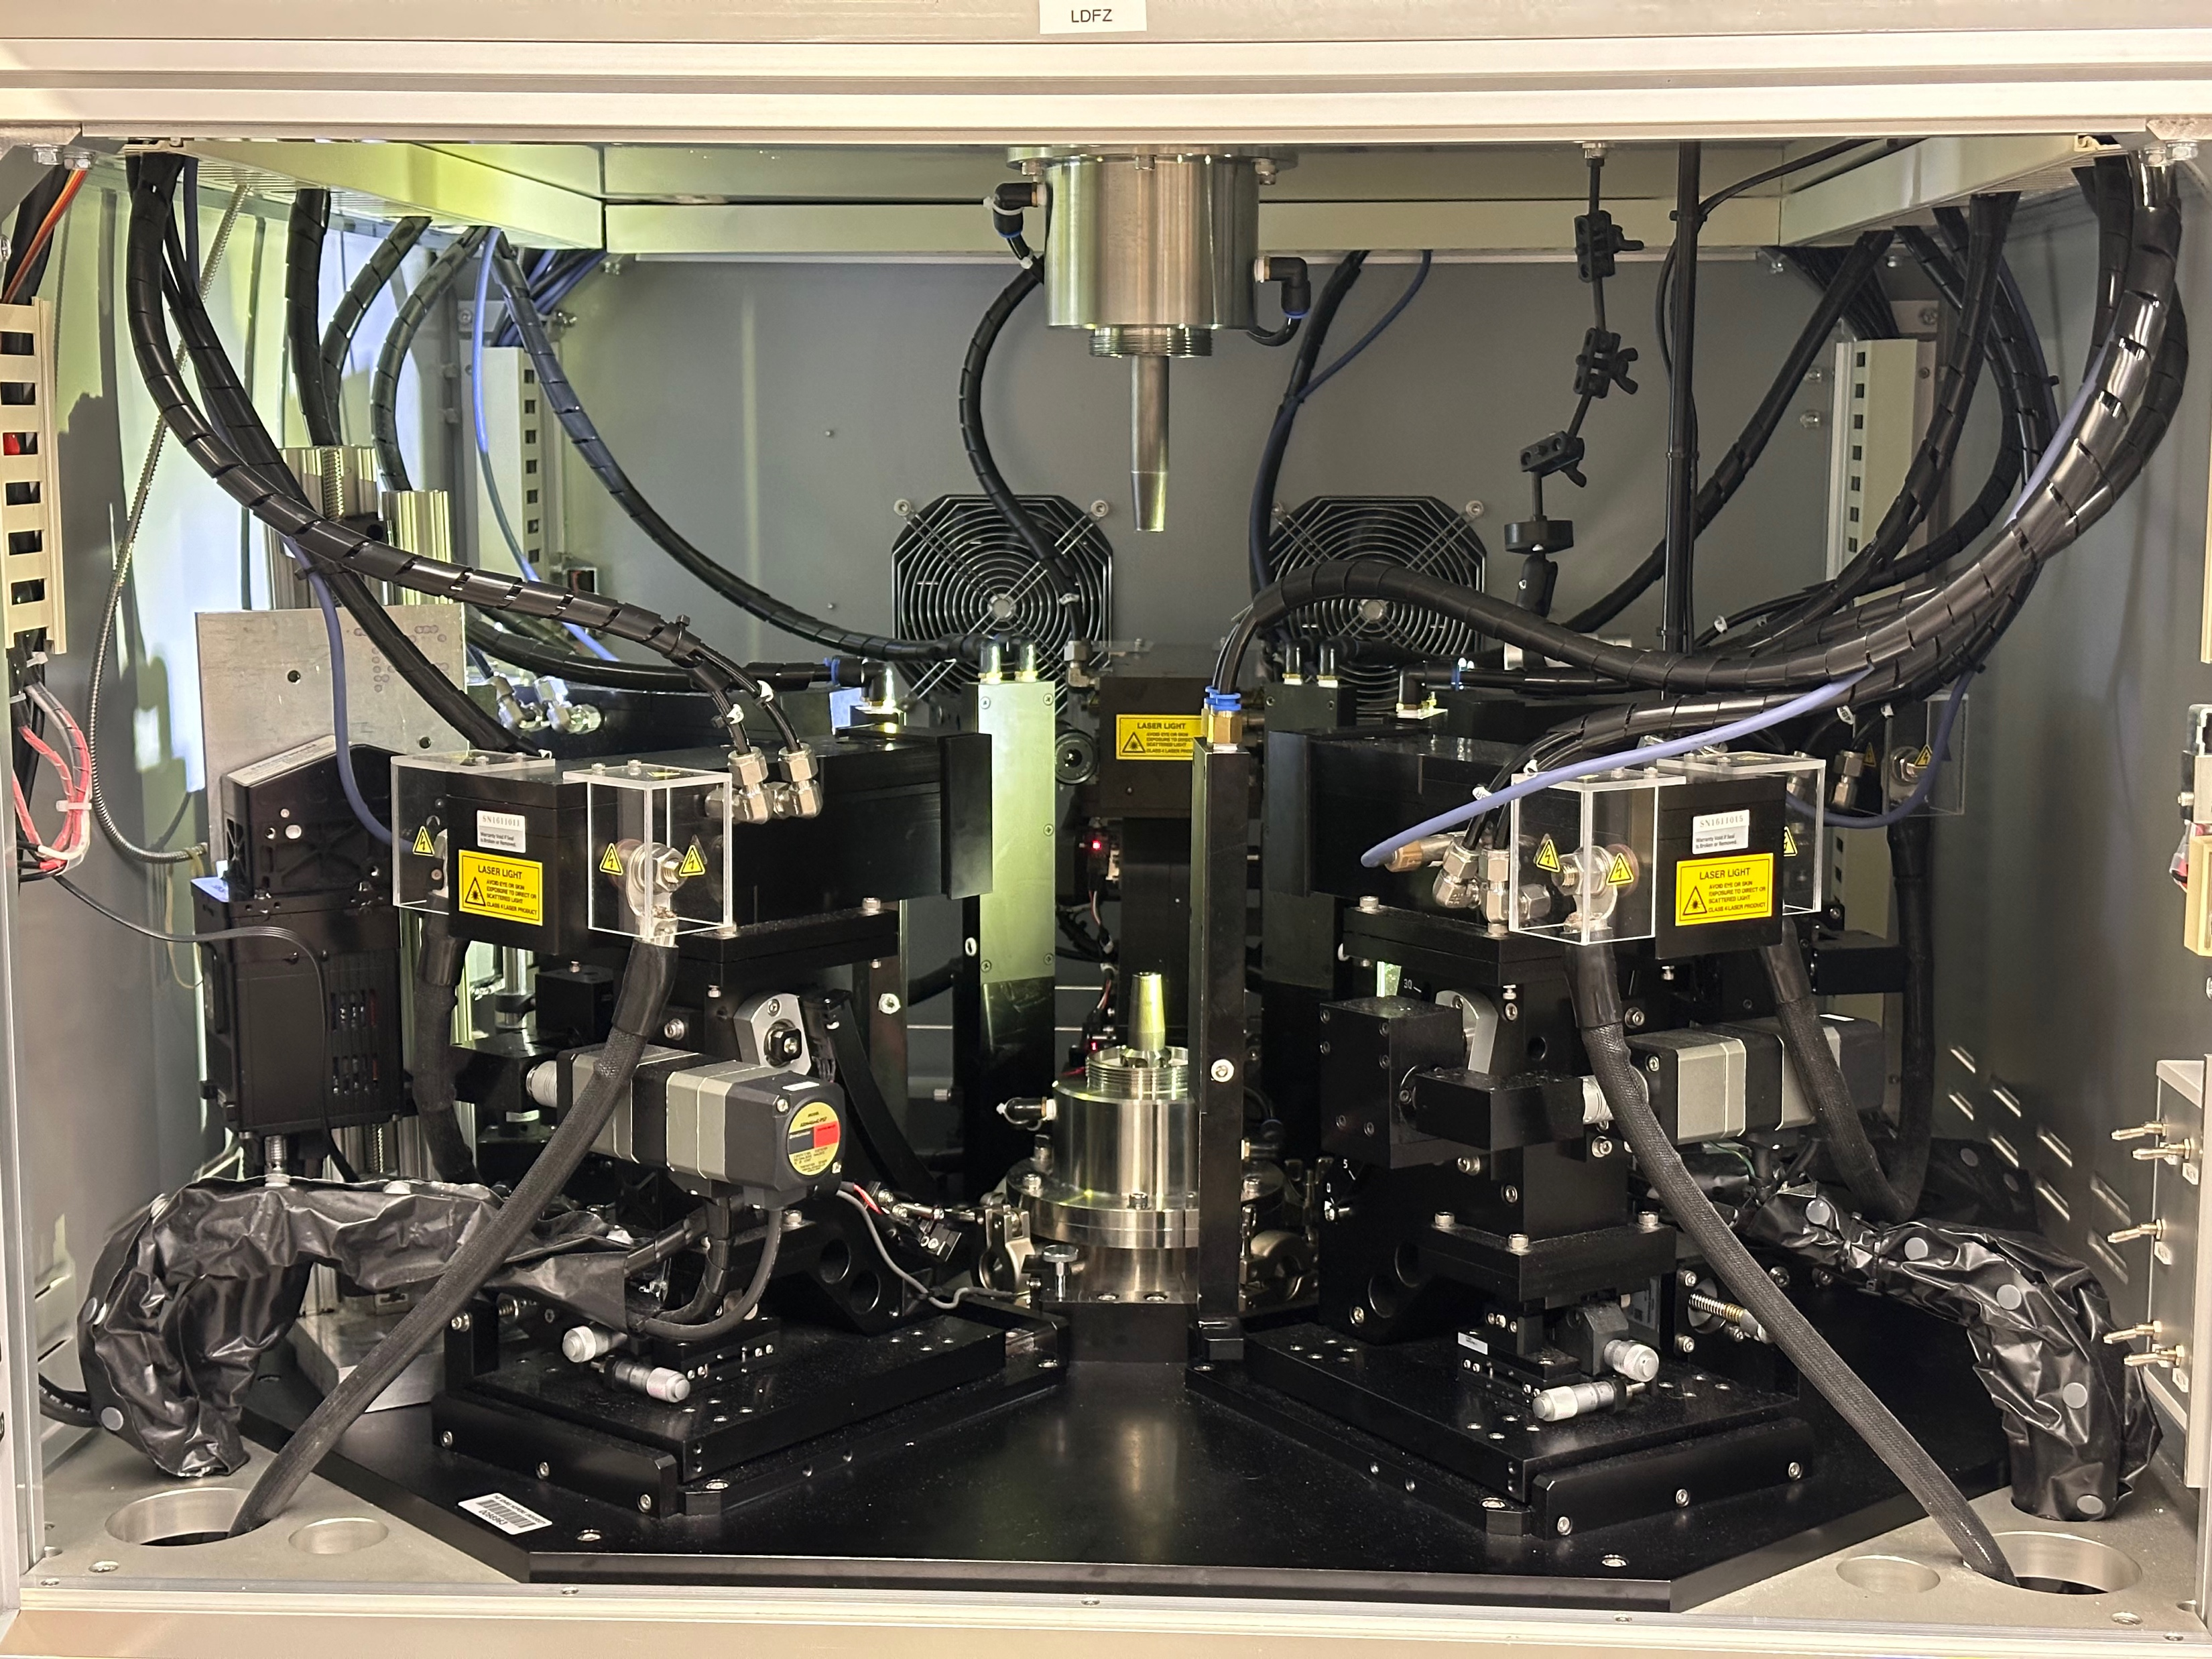
Laser Diode Floating Zone

Slide 3
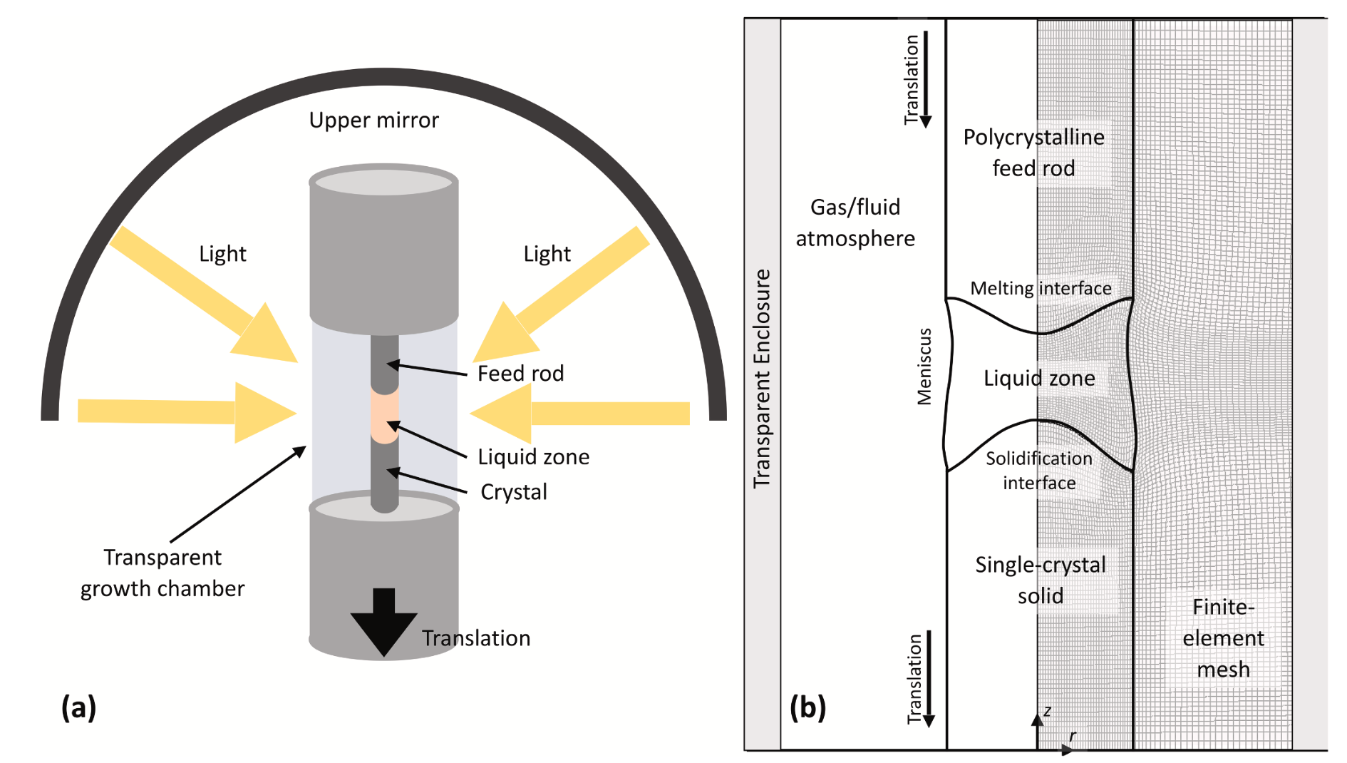
Scott S. Dossa, Jeffrey J. Derby
https://doi.org/10.1016/j.jcrysgro.2022.126723

Slide 4
Digital Twins

Slide 5
Digital Twins
A digital twin is a virtual representation of an object or system designed to reflect a physical object accurately.
-IBM
Notes:
Why do we want to make digital twins?

Slide 6
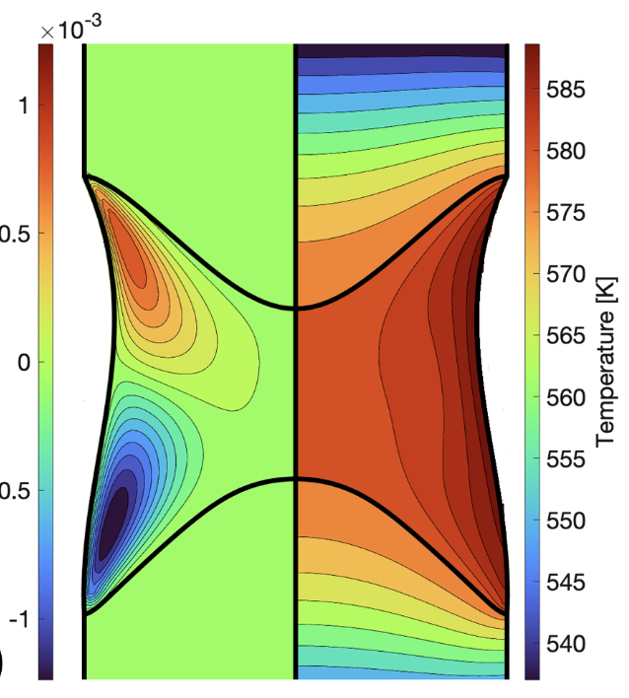
Modeling – NaNO₃
Scott S. Dossa, Jeffrey J. Derby
https://doi.org/10.1016/j.jcrysgro.2022.126723
6
Notes:
Talk about what is missing from this modeling – to make a digital twin we need actual experimental data to validate it
This takes temperatures as an input, so it’s like starting in the middle of a growth with know temperature field rather that from the beginning of the growth
Temperature is a critical parameter that is missing from these models

Slide 7
Research Question
How can we collect temperature data from lab growths?

Slide 8
Acknowledgements
Evan Crites
Maggie Eminizer
NSF - PARADIM #2039380 and Award #2129051 (VariMat)
8

